Slide 1

AGROVIKAS

Slide 2




Meet Our Team
Rishi Patel
Krish Goswami
Jalpan Patel
Jil Patel

Slide 3
Problem
Shortage of agricultural machinery like thresher
Unfair pricing practices by local stores.
Limited choices for consumers.
Low income for farmers due to low buying prices
In current scenario there is no aviability of online platform for purchaseing agricultural Machinery.

Slide 4
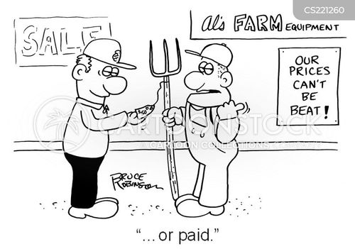
Problem : Inefficiencies in Agricultural Machinery Procurement and maintainance
1.High Cost
2.Limited access of information
3.Geographical Barrier
4.Complex supply chain
5.Lack of after-sales services

Slide 5
Solution
Develop a mobile application for selling agricultural machinery.
In agricultural sector it work as amazon or flipkart.
Create a user-friendly interface for farmers, dealers, and manufacturers.
Offer a wide range of agricultural machinery, including tractors, harvesters, tillers, etc.
we will also provide maintaince and repair of agricultural machinery store details.

Slide 6

Solution : Provide cost effective purchase option and maintainance in form of online application
1.Transparent pricing
2.Access to information
3.Wider reach
4.Logistics and Delievery
5.After-Sales Services

Slide 7

Extra-features of our application :
1.Variety of product
2.Customer Reviews and Ratings
3.Detailed product listings

Slide 8

THANK YOU

